Slide 1

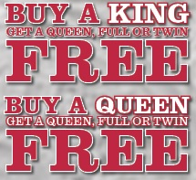
Tent Sale
Beautyrest™ Plush
Factory Select Mattress
with Triton® Lite-Foundation
FEATURES:
11.5” Mattress Profile
815 Density Pocketed Coil® Technology
SurfaceCool™ Fiber
AirCool® Foam
GelTouch® Foam
Factory Select Cover **
May be a different pattern &/or fabric
Queen Set | $699 Reg $1099
King Set | $899 Reg $1499

