Slide 1
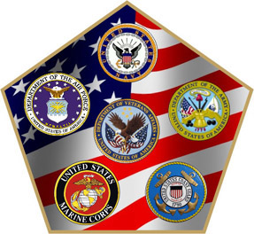
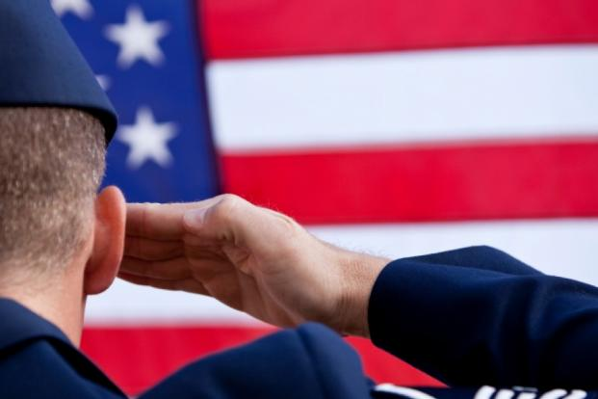
“My heroes are those who risk their lives every day to protect our world and make it a better place. Our flag does not fly because the wind moves it… it flies with the last breath of each soldier who died protecting it”.
America’s Mattress is your luxury mattress store. We are locally owned and Veteran Operated . The sacrifice and selfless service provided by our men and women in uniform allow us to peacefully sleep at night. We at America’s Mattress want our men and women in uniform to receive the same peaceful sleep at night they provide us! We have incentives for our men and women in uniform 7 days a week!
Store Address:
7445 Academy Blvd N.
Colorado Springs, Colorado 80920
(719) 598-9417
www.americasmattress.com/coloradosprings

